Slide 1
动手学PYTORCH 神经网络模型量化之入门篇-I(重制版）
神经网络模型量化算法实战系列课程
每月一更
HISRG

Slide 2




暖场：现实题材影片的时代背景
21世纪10年代的“新农村”建设
20世纪60年代末知识青年下乡
21世纪10年代的医改
20世纪末的国家“扫盲”计划
而本课程讨论的时代背景是国家正在实施“碳中和”计划，目的是用量化技术来降低AI模型在推理时所消耗的能量！欢迎继续往下看！
Sep,2022,no commercial in this page

Slide 3

本期大纲
课程概述
预备知识
神经网络模型量化动机与收益
Pytorch 量化历史回顾
Pytorch 支持的量化类型
Pytorch eager 量化与fx mode 量化
参考文献

Slide 4

课程概述
本课程为神经网络模型量化算法的实战课，与理论课系列相对应，理论课主要以读论文的形式介绍量化算法的原理，同样也是每月一更，而本系列课程侧重于实战，学了本系列课程后方便大家基于PYTORCH(后面简称PT)框架展开神经网络模型量化算法的研究与前期部署，重点关注量化后的精度损失程度以及恢复措施。若要通过神经网络模型量化算法获得更加可观的收益，如极致的速度与能耗比，则需要深入结合硬件厂商提供的AI 加速平台，如Intel Openvino/INC， Qualcomm SNPE，NVIDIA TensorRT, AMD/XILINX Vitis 等， 现在开始吧！

Slide 5
预备知识
Background Requirements

Slide 6
预备知识
Items | Name | Reference resource | comments
1 | PT 基本编程原理 | https://space.bilibili.com/1567748478/channel/seriesdetail?sid=358497 | 沐神大作
2 | DNN算法原理 | https://space.bilibili.com/1567748478/channel/collectiondetail?sid=32744 | 沐神大作
3 | DNN量化算法综述 | A Survey of Quantization Methods for Efficient Neural Network Inference, https://arxiv.org/pdf/2103.13630.pdf | 综述全面
4 | DNN量化 白皮书I | A White Paper on Neural Network Quantization https://arxiv.org/pdf/2106.08295.pdf | Qualcomm 出品 for mobile
5 | DNN量化 白皮书II | INTEGER QUANTIZATION FOR DEEP LEARNING INFERENCE:PRINCIPLES AND EMPIRICAL EVALUATION https://arxiv.org/pdf/2004.09602.pdf | NVIDIA 出品 For cloud
6 | 快速指南 | https://www.bilibili.com/video/BV1Hh411W7Tw/?spm_id_from=333.788.recommend_more_video.-1&vd_source=abd970231d038b6d5feec86f17fe7f61 | Sense Time 出品

Slide 7
神经网络模型量化动机与收益
DNN quantization motivation and benefit

Slide 8
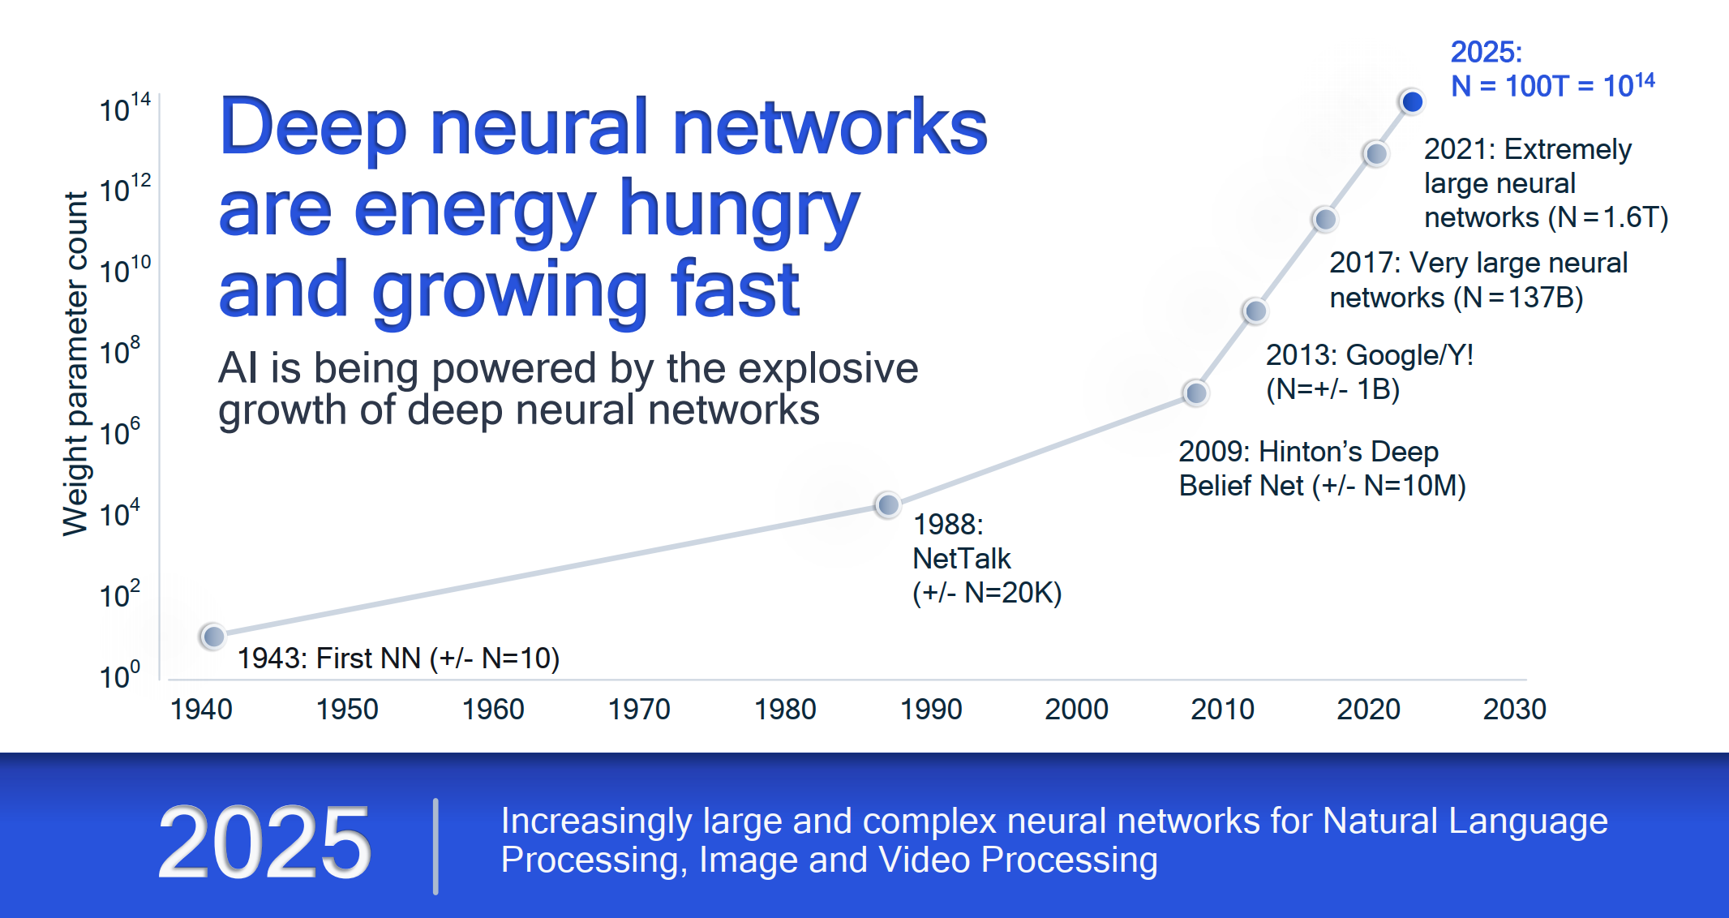
神经网络模型量化动机与收益
Ref: https://cms.tinyml.org/wp-content/uploads/industry-news/tinyML_Talks-_Marios_Fournarakis_210929.pdf

Slide 9
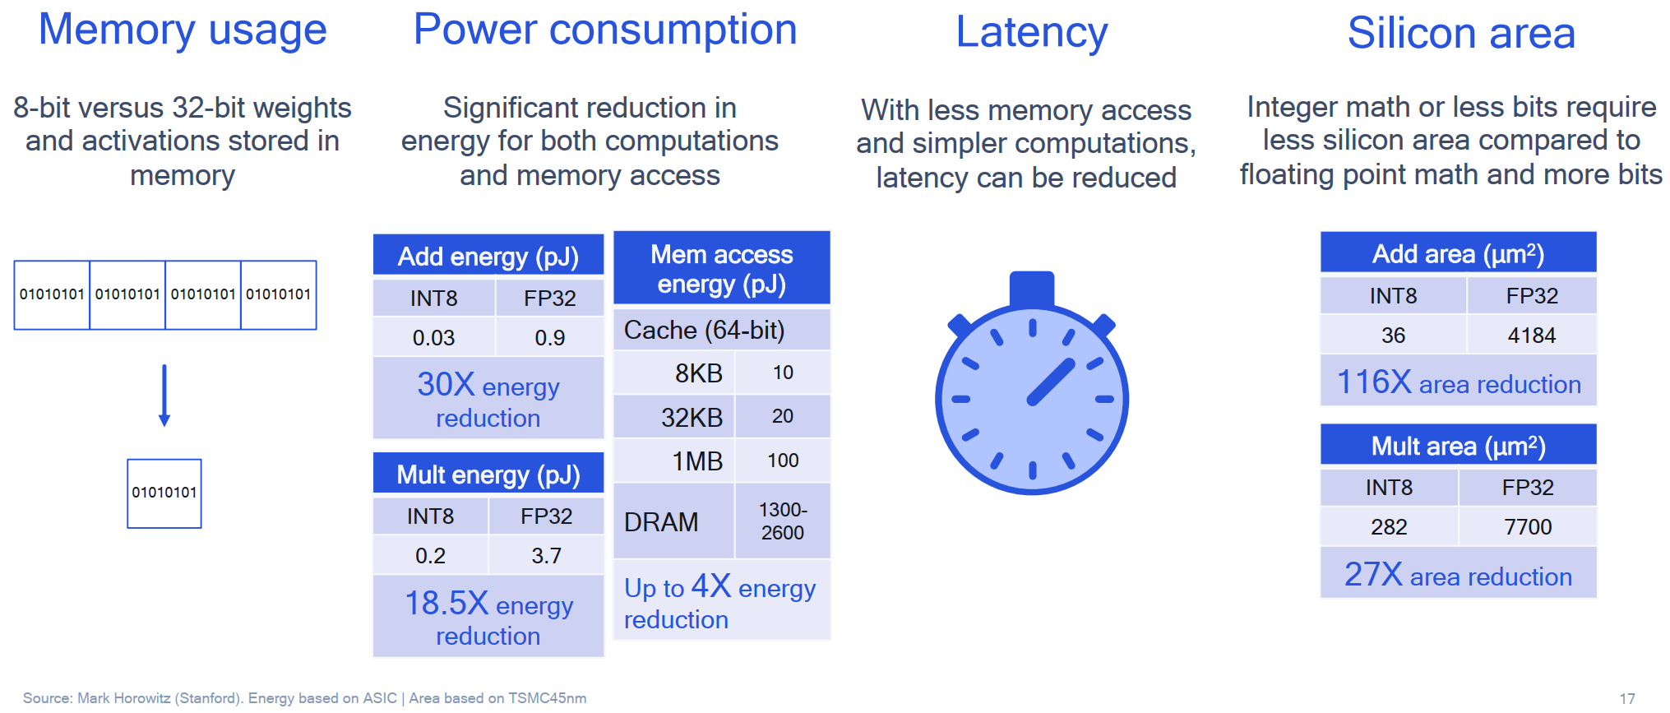
神经网络模型量化动机与收益
Ref: https://cms.tinyml.org/wp-content/uploads/industry-news/tinyML_Talks-_Marios_Fournarakis_210929.pdf

Slide 10
Pytorch 量化历史回顾
版本 | 主要特性
PyTorch 1.1 | 实验性支持Tensor 级别的torch.qint8 dtype, torch.quantize_linear
PyTorch 1.3 | 正式支持量化功能，新增CNN网络中的常见的量化OP，如Conv2d, Relu……
PyTorch 1.4 | 新增量化版本网络，如ResNet，mobileNetV2, InceptionV3……
PyTorch 1.5 | 新增动态量化功能以及一些新的量化OP，如leaky relu, BN
PyTorch 1.6 | 新增训练时量化功能（QAT)以及LSTMCell等量化OP
PyTorch 1.7 | 新增FP16量化功能以及Embedding 等面向NLP网络的量化OP
PyTorch 1.8 | 新增FX量化模式
……
PyTorch 1.12 | 本课程推荐的版本！CPU
PyTorch specifically | 取决于硬件厂商做特殊的优化， 如CUDA，SNPE
Ref: https://mp.weixin.qq.com/s/wzAgIS1Omm-K-4-tx68CCQ

Slide 11
PT 支持的量化模式
The quantization mode which PT supports

Slide 12
Pytorch 支持的量化模式
量化模式 |  | 解释 | 校准/微调 | 适用场景 | 备注
Post Training Quantization (训练后量化） | Dynamic /Weight Only Quantization | activation dynamically quantized (fp16, int8) or not quantized, weight statically quantized (fp16, int8, int4) | None | LSTM, MLP, Embedding, Transformer | good | Easy to use, close to static quantization when performance is computed or memory bound due to weights
 | Static Quantization | acivation and weights statically quantized (int8) | calibration dataset | CNN | good | Provides best perf, may have big impact on accuracy, good for hardwares that only support int8 computation
Quantization Aware Training (量化感知训练） | Dynamic Quantization | activation and weight are fake quantized | fine-tuning dataset | MLP, Embedding | best | Limited support for now
 | Static Quantization | Activation and weight are fake quantized | fine-tuning dataset | CNN, MLP, Embedding | best | Typically used when static quantization leads to bad accuracy, and used to close the accuracy gap

Slide 13
PT eager 量化与fx mode 量化
Eager & FX MODE

Slide 14
Pytorch 后端/硬件支持
硬件 | Kernel 库 | Eager 模式 | FX 模式[1] | 量化模式支持 | 调用指令集
服务器CPU | fbgemm | 支持 |  | 动态/静态都支持 | AVX2/AVX512
移动 CPU | qnnpack/xnnpack |  |  |  | NEON
服务器 GPU | TensorRT | 部分支持 | 支持 | 支持静态量化 | FXTRT
[1] more about FX mode 请参考:https://arxiv.org/pdf/2112.08429.pdf

Slide 15
Pytorch eager 模式与FX 模式对比
Items | Eager Mode Quantization | FX Graph Mode Quantization
Release Status | beta | Prototype
Operator Fusion | Manual | Automatic
Quant/DeQuant Placement | Manual | Automatic
Quantizing Modules | Supported | Supported
Quantizing Functionals/Torch Ops | Manual | Automatic
Support for Customization | Limited Support | Fully Supported
Quantization Mode Support | Post Training Quantization: Static, Dynamic, Weight Only Quantization Aware Training: Static | Post Training Quantization: Static, Dynamic, Weight Only Quantization Aware Training: Static
Input/Output Model Type | torch.nn.Module | torch.nn.Module (May need some refactors to make the model compatible with FX Graph Mode Quantization)

Slide 16

Pytorch eager 量化案例
Example for pytorch eager quantization

Slide 17
Pytorch eager 量化案例
插入eager 节点
原始网络模型
class NetQuant(nn.Module):
def __init__(self, num_channels=1):
super(NetQuant, self).__init__()
self.conv1 = nn.Conv2d(num_channels, 40, 3, 1)
self.relu1 = nn.ReLU()
self.pool1 = nn.MaxPool2d(2, 2)
self.conv2 = nn.Conv2d(40, 40, 3, 1)
self.relu2 = nn.ReLU()
self.pool2 = nn.MaxPool2d(2, 2)
self.fc = nn.Linear(5*5*40, 10)
self.quant = torch.quantization.QuantStub()
self.dequant = torch.quantization.DeQuantStub()
def forward(self, x):
x = self.quant(x)
x = self.relu1(self.conv1(x))
x = self.pool1(x)
x = self.relu2(self.conv2(x))
x = self.pool2(x)
x = x.reshape(-1, 5*5*40)
x = self.fc(x)
x = self.dequant(x)
return x
class Net(nn.Module):
def __init__(self, num_channels=1):
super(Net, self).__init__()
self.conv1 = nn.Conv2d(num_channels, 40, 3, 1)
self.conv2 = nn.Conv2d(40, 40, 3, 1)
self.fc = nn.Linear(5*5*40, 10)
def forward(self, x):
x = F.relu(self.conv1(x))
x = F.max_pool2d(x, 2, 2)
x = F.relu(self.conv2(x))
x = F.max_pool2d(x, 2, 2)
x = x.reshape(-1, 5*5*40)
x = self.fc(x)
return x

Slide 18
Example for eager VS FX mode
model = NetQuant()
model.qconfig = torch.quantization.get_default_qconfig('fbgemm')
modules_to_fuse = [['conv1', 'relu1'], ['conv2', 'relu2']] # 指定合并layer的名字
model_fused = torch.quantization.fuse_modules(model, modules_to_fuse)
model_prepared = torch.quantization.prepare(model_fused)
post_training_quantize(model_prepared, train_loader) # 这一步是做后训练量化
model_int8 = torch.quantization.convert(model_prepared)
from torch.quantization import get_default_qconfig, quantize_jit
from torch.quantization.quantize_fx import prepare_fx, convert_fx
model = Net()
qconfig = get_default_qconfig("fbgemm")
qconfig_dict = {"": qconfig}#https://github.com/pytorch/pytorch/blob/master/torch/ao/quantization/qconfig.py
model_prepared = prepare_fx(model, qconfig_dict)
post_training_quantize(model_prepared, train_loader) # 这一步是做后训练量化
model_int8 = convert_fx(model_prepared)

Slide 19
代码演示

Slide 20
总结
由此可见使用FX graph 模式开发量化算法，从效率上讲要明显优越于eager mode 的，同时，诸如MQBench都是基于FX graph 的基础之上封装量化算法,这也将是本系列课程重点讨论的内容！

Slide 21
参考文献
https://pytorch.org/docs/stable/quantization.html#quantized-model
https://cms.tinyml.org/wp-content/uploads/industry-news/tinyML_Talks-_Marios_Fournarakis_210929.pdf
https://arxiv.org/pdf/2112.08429.pdf
https://blog.csdn.net/IAMoldpan/article/details/124903484

Slide 22
Next introduction
如何利用PT 评估模型量化前后的损失？

Slide 23




Thank you
Presenter name
Email address
Website

